Slide 1
Comments and Conventions
COMP110

Slide 2
Learning Objectives
By the end of this section you should be able to:
Discuss coding style, including why good style can help programmers debug code
Recognise important aspects of style such as naming, alignment, locality, and comments
Recall important Python conventions
Apply conventions in your Python code consistently

Slide 3
Coding Style

Slide 4
Coding Style
Programmers spend an enormous amount of time reading and studying code when they are writing, testing, and debugging their programs.
Using good programming style allows this process to proceed much more easily.

Slide 5
Coding Style
When writing a program using iterative-enhancement approach (i.e., going through it again and again to improve it), it is an excellent idea to beautify your code at the end of each stage, before proceeding to the next stage (or task).

Slide 6
Coding Style
Ultimately, this strategy will save you time compared to the strategy often used by students: ignore style until the program is completely written.
Such a strategy poor!
It is harder to "finish" a poorly-styled program, because it is harder to read and understand it; and misunderstanding introduces bugs and makes them more difficult to detect

Slide 7
Coding Style
Software engineers read code more often than they write code, trying to understand how it works and to make adaptations.
It is important to practice being disciplined and applying conventions readily to overcome temptations to write bad code to fix later.

Slide 8
Coding Style
In the real world, companies have their own style guidelines, which all their programmers must follow.
In this way, code written by different programmers is consistent (and therefore more easily readable by other programmers). So, it is not unreasonable for me to ask you to write in a certain style, as consistently as you can.

Slide 9
CLAN Considerations
Four key considerations when discussing code conventions are:
Comments
Locality
Alignment
Names

Slide 10
Comments
We document our programs with comments. While we try to express ourselves as well as we can with Java code, there is always other useful information about a program that we would like communicate to programmers reading our code (including ourself, while debugging it, or at some future date to remind us).

Slide 11
Comments
Such information is for programmers, not the computer: not the instructions saying HOW the code works (that is for the programmer and computer), but WHAT the program does and WHY it does it (that way). We supply this information in comments.

Slide 12
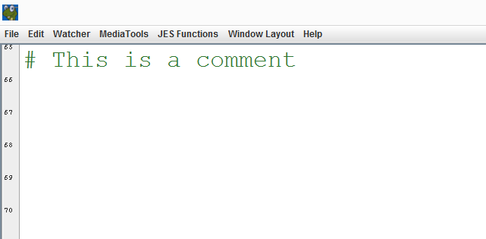
Comments
In python, use the # symbol to write a comment

Slide 13
Comments
Like the other rules of good style, comments are best included while the program is being written, not after it is working.
I find and correct many errors while writing comments, because I am focusing on the code while writing about it.

Slide 14
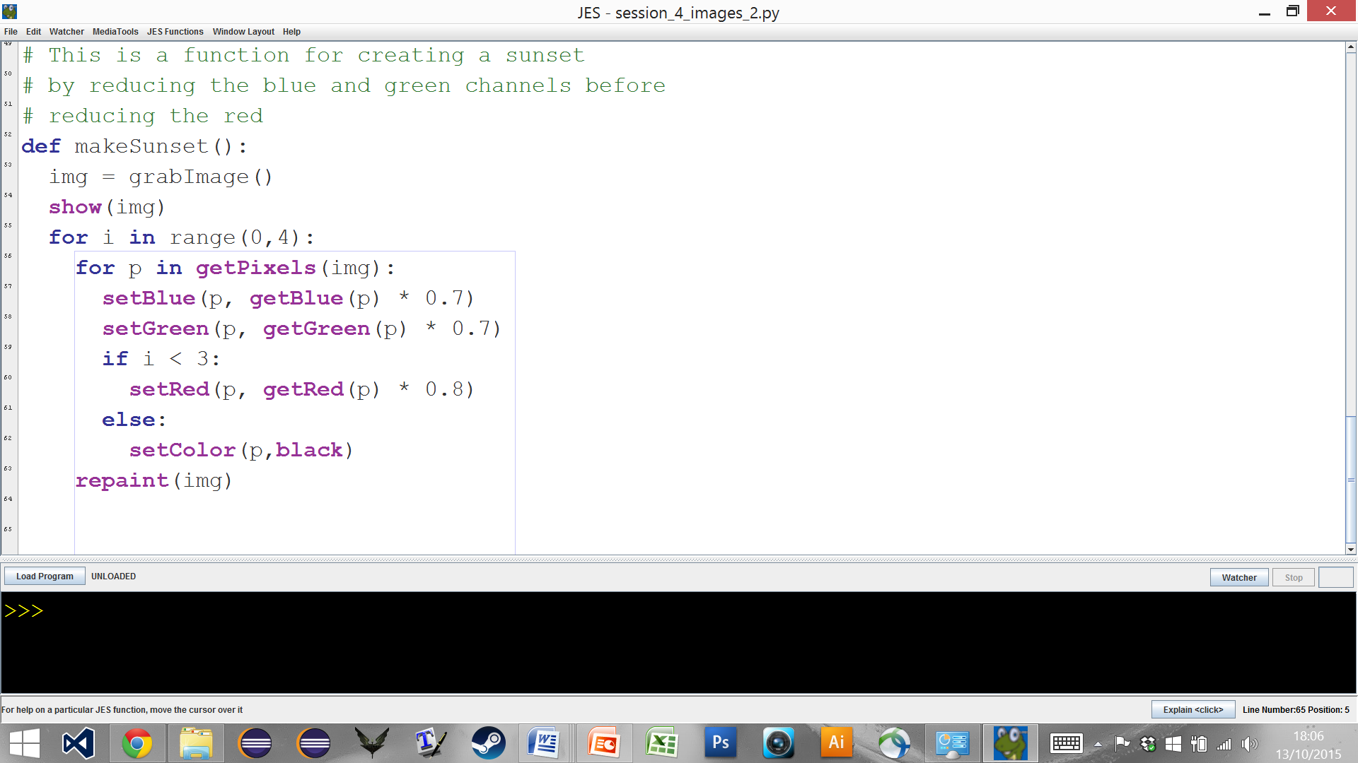
Comments
Preface comments act as a topic-sentence, describing a group of related statements that directly follow the comment.

Slide 15
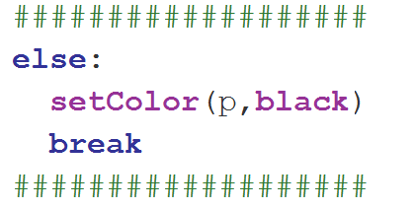
Comments
Sandwhich comments directly preface and suffix some statement.

Slide 16
Comments
Use a sandwhich comment to make the if/break statements terminating a long/complex loop easy to locate.

Slide 17
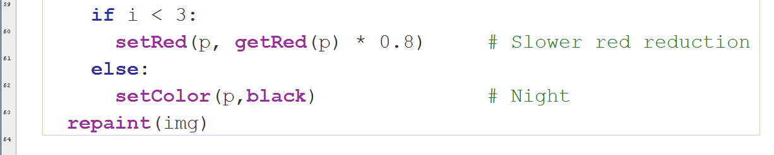
Comments
Sidebar comments appear on the same line, after some statement. They help explain that statement.

Slide 18
Comments
Use alignment so that all the sidebar comments are aligned: that makes it very easy to have the code separated from the comments.

Slide 19
Comments
Always avoid mingling comments within code; separate them for clarity. This leads into the principle of locality.

Slide 20
Locality
Locality involves mostly adding extra vertical whitespace (blank lines).
By grouping statements together and then placing blank lines between groups, we create the programming equivalent of paragraphs.

Slide 21
Locality
Locality is the most subjective aspect o programming style
Typically, each code group should contain a half-dozen statements. The magic number 7+/-2 is also used for psychological reasons: it represents the number of items typically usable in the brain's short-term memory.

Slide 22
Locality
Whenever a large number of statements appear in a block of code, use blank lines to group them into a smaller number of related sequences. We can write a preface comment (see below) that acts as a topic sentence for the paragraph of code.

Slide 23
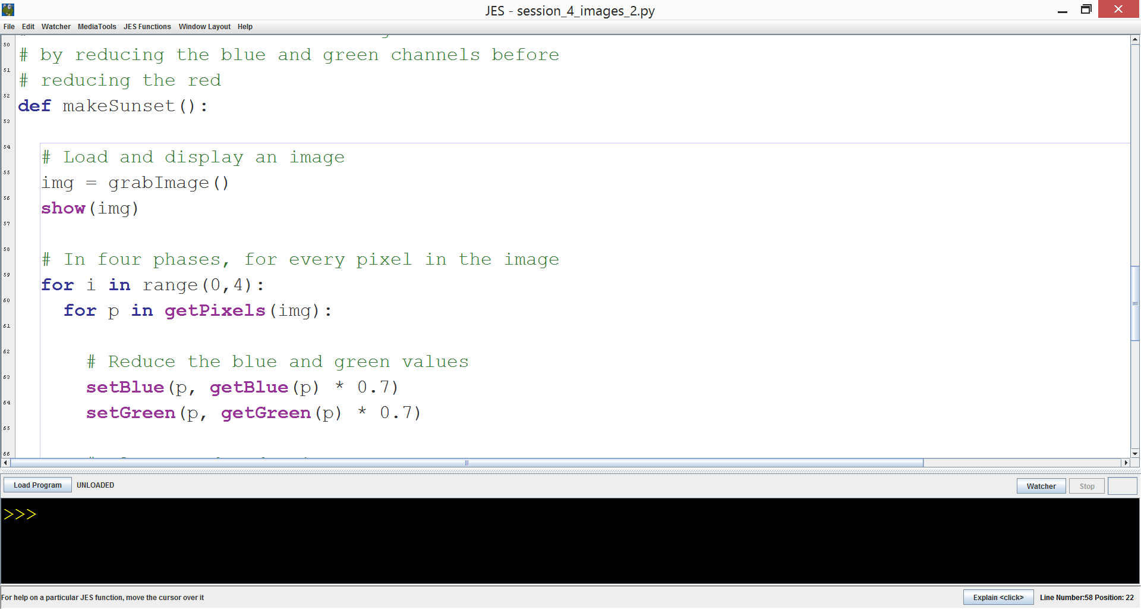
Locality

Slide 24
Alignment
We use whitespace to present our programs (to humans, not computers) in an easy to read and understand form.

Slide 25
Alignment
Alignment involves mostly using horizontal whitespace. The most important use of alignment is showing which statements are controlled by which control structures (i.e., blocks).

Slide 26
Alignment
The controlled statements are always indented to appear inside the statements that control them.
This relationship is the essence of using control structures, so the indication it is critical to ensure readability.

Slide 27
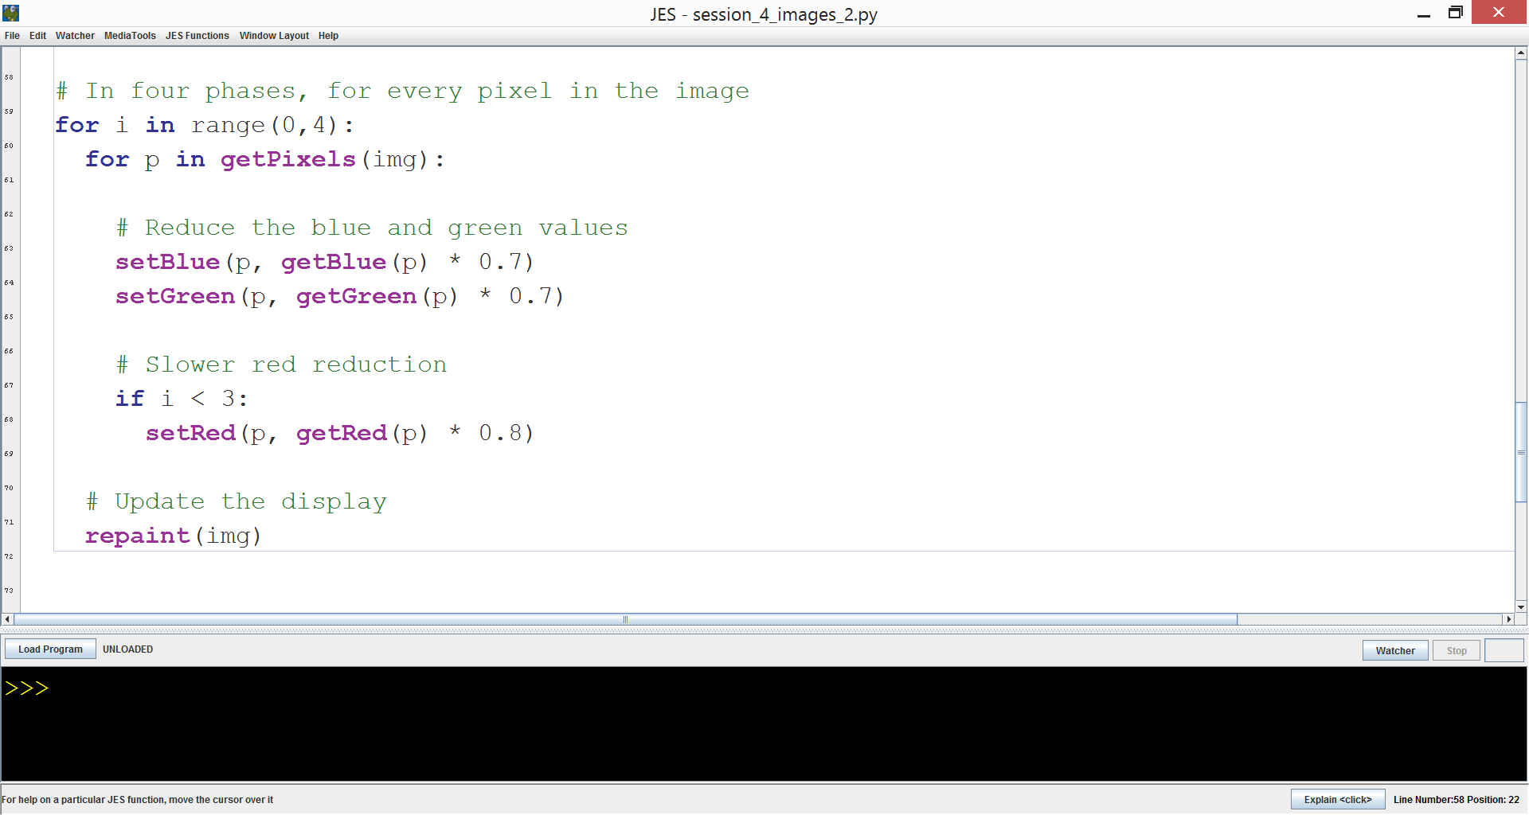
Alignment

Slide 28
Names
Programmers chose the names of variables, functions, classes, exceptions, and so on.
It is important that meaningful names are used, so that other programmers can understand what the code represents.

Slide 29
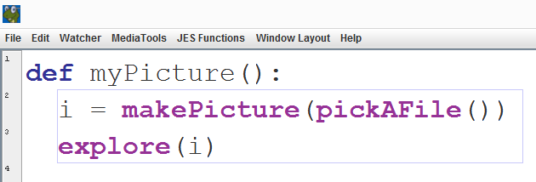
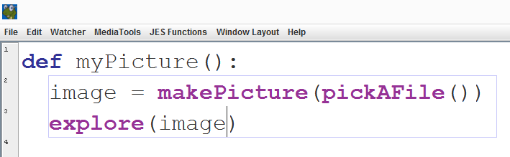
Names
A common problem is chosing names that are too short.

Slide 30
Names
Using longer names requires a bit more typing (which costs some time) and takes longer to read (ditto) but it makes it much easier for you to understand your program as you are enhancing/debugging it (which saves much much much more time)

Slide 31
Names
camelCase
snake_case
CAPITALS

Slide 32
Names
thisIsAVariable
thisIsAFunction()
THIS_IS_A_CONSTANT
ThisIsAClass

Slide 33
Further Python Conventions
https://www.python.org/dev/peps/pep-0008/
http://ocw.mit.edu/courses/electrical-engineering-and-computer-science/6-189-a-gentle-introduction-to-programming-using-python-january-iap-2011/lectures/MIT6_189IAP11_comment.pdf

Slide 34
Drawing with turtles

Slide 35
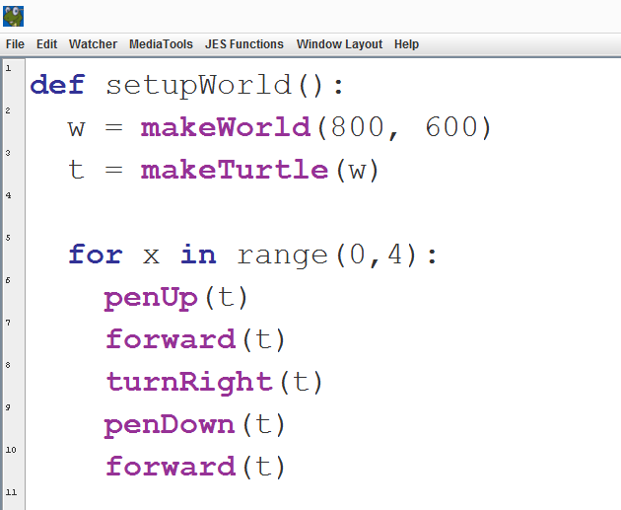
Setting Up Turtles in JES

Slide 36
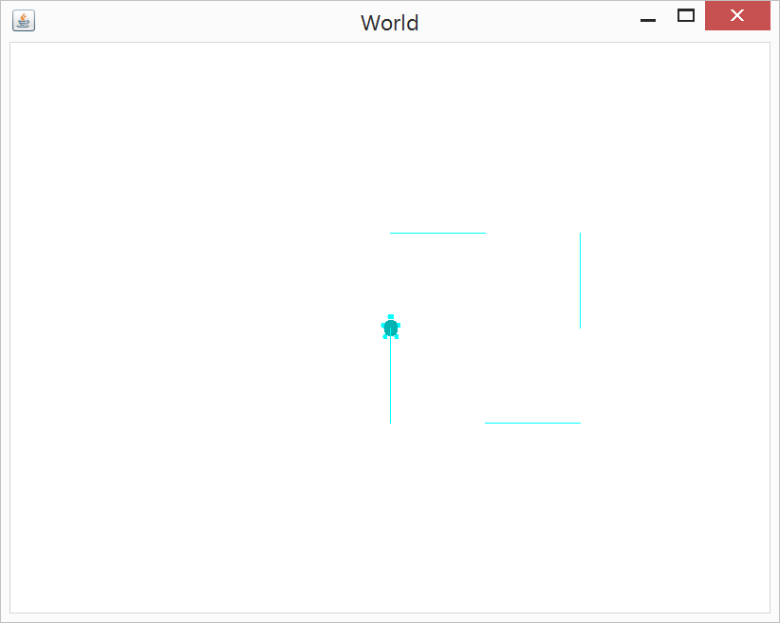
Setting Up Turtles in JES

Slide 37
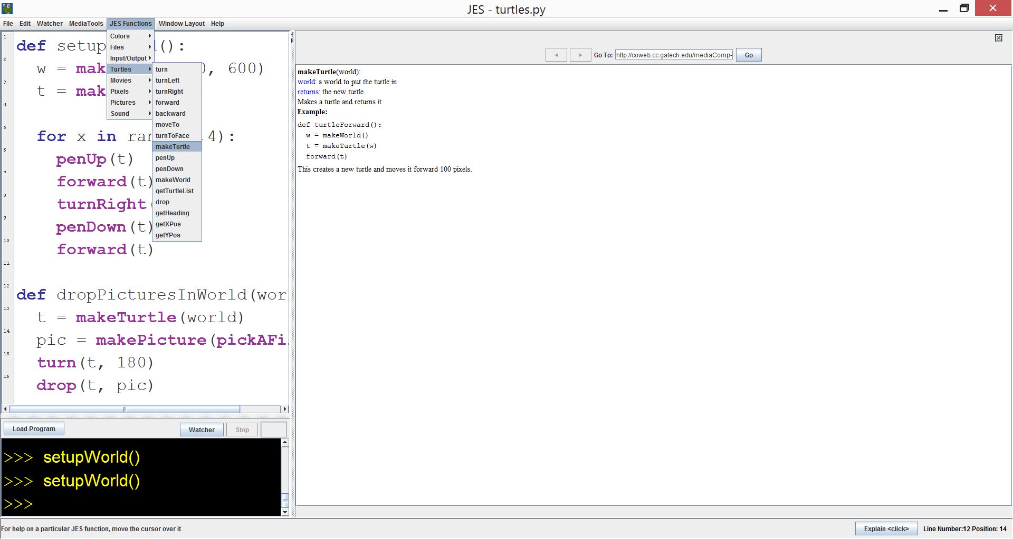
Setting Up Turtles in JES

Slide 38
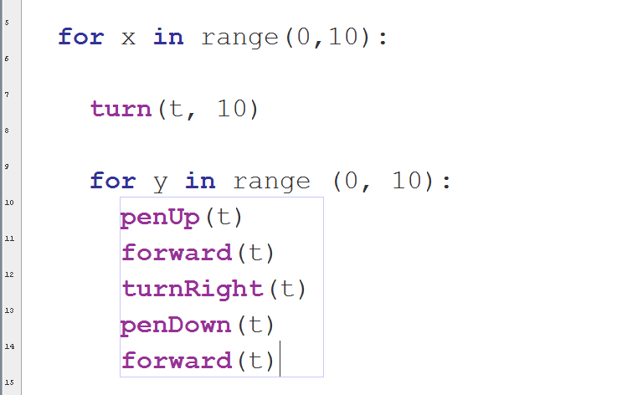
Nested Loops
Loops within loops:

Slide 39
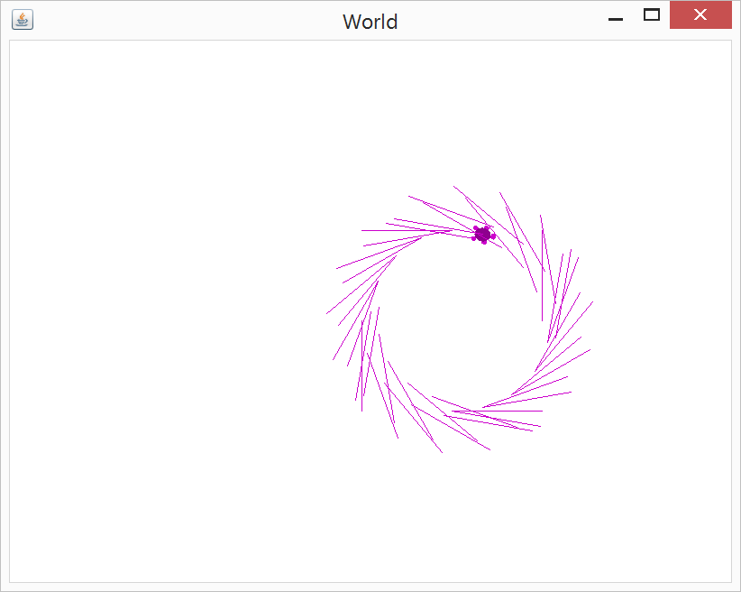
Nested Loops

Slide 40
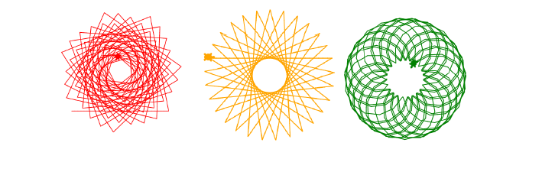
Turtle Activity
You can use makeTurtle() to create multiple turtles within the world.

Slide 41
Turtle Activity
Write Python code to create at least three spiral patterns
Use a range of while loops, for loops, if statements, and nesting
Make them as interesting as possible
Comment your code appropriately
Post your solutions (and spirals) to Slack

